Slide 1

Get In Touch With Us
Himalaya Classification Project
Predicting high-altitude mountaineering insurance premiums through data science
Felix Grabscheit
Philipp Kron
Master Data Science WS2019.20
Introduction to Data Science

Slide 2
Data Science Problem
Project Summary
Default risk assessment
Decide if a particular outcome is likely to occur and identify important attributes
The focus of this project is to demonstrate the general use case of data science methods for insurance rate making purposes.
Our objective is to predict the likelihood of high-altitude mountaineering accidents based on a real-world database.
A predictive model is used to estimate an individual risk level for customers and serves as basis for insurance premiums.
Data Science Technique
Marketers must link the price to the real and perceived value of the product, but they also must.
Real world application
The method discussed in this project can be used to support various kinds of risk based decision making processes

Slide 3
Agenda
Domain Exploration
Business Opportunity
Data Science in Insurance
Database origin and veracity
Data Exploration
Data extraction and basic modifications
Data cleaning
Descriptive Statistics

Slide 4
Data Preparation
Marketers must link the price to the real and perceived value of the product, but they also must
Modeling
Marketers must link the price to the real and perceived value of the product, but they also must
Model evaluation
Marketers must link the price to the real and perceived value of the product, but they also must
Results interpretation
Marketers must link the price to the real and perceived value of the product, but they also must take into account supply costs.

Slide 5

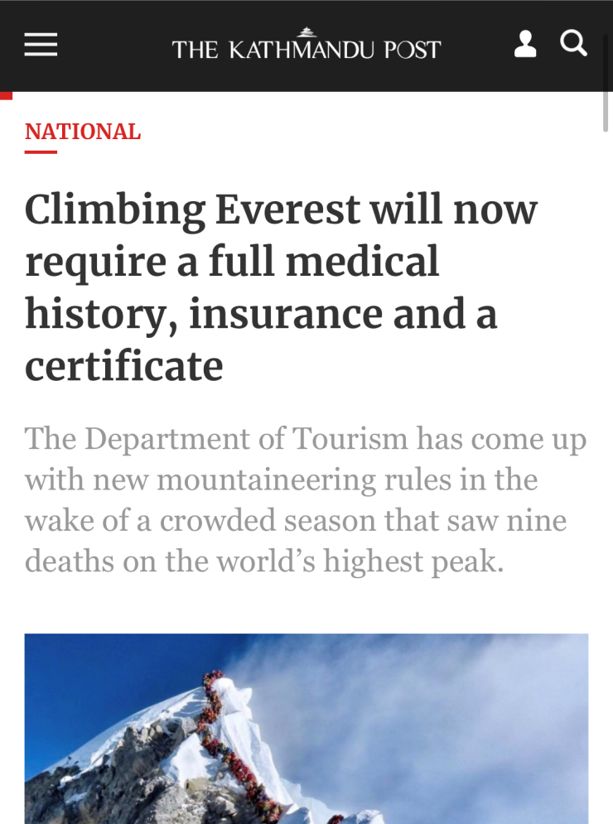

Business Opportunity
After the 2019 climbing season in Nepal going down as one of the deadliest seasons in history, Nepal's Department of Tourism enforced new requirements for climbing high altitude mountains in Nepal.
One being an insurance for search, rescue and treatment of climbers in in emergency situations.
Market Potential
3.136 Climbing permits issued in 2018*
29.000 Trekking tourists in 2018*
Financially strong customer base
Since we have no previous knowledge of this type of insurance and the risks involved, we try to solve this with Data Science techniques.
https://kathmandupost.com/2/2019/12/15/climbing-everest-will-now-require-a-full-medical-history-insurance-and-a-certificate
Notes:
“It’s search, rescue and treatment insurance, which will allow rescues and prompt treatment if the mountaineer is ill or stuck at high altitude,” said Acharya. “The insurance will also partly cover retrieval of the body in case of death.” https://tkpo.st/2PR9yNG
Retrieving a body above the death zone, which is above 8,000 metres, can cost around $200,000 and costs to rescue people below the death zone ranges from $20,000 to $60,000, according to rescue operators, depending on the location and situation.

Slide 6
Data Science in Insurance
Price optimization
Fraud detection
Comparing competition premiums and customer price sensitivity allows for better premiums
management
Help recognize fraud schemes by detecting suspicious claim patterns and behavior.
Actuary vs Data Science Marketers must link the price to the real and perceived value of the product, but they also must take into account supply costs, seasonal discounts, and prices used by competitors. In some cases, business executives. Place decisions outline where the product is sold and how it is delivered to the market.
Although many data science applications (customer management, consumer targeting) are similar to other industries, there are a few special applications.
Claims prediction
Risk assessment
Forecasting the height of claims helps charging competitive premiums and speed up settlement
Identify risk reasons and quantification among risk groups to improve profitability
K. Umamaheswari, Role of Data mining in Insurance Industry, COMPUSOFT, June 2014
Notes:
„there are no bad risks only bad pricing“
Price sensitivity: Wo kommt Kunde her, Kündigungsvergangenheit, Reaktion auf Preiserhöhung
https://cloud.google.com/blog/products/gcp/using-machine-learning-for-insurance-pricing-optimization

Slide 7
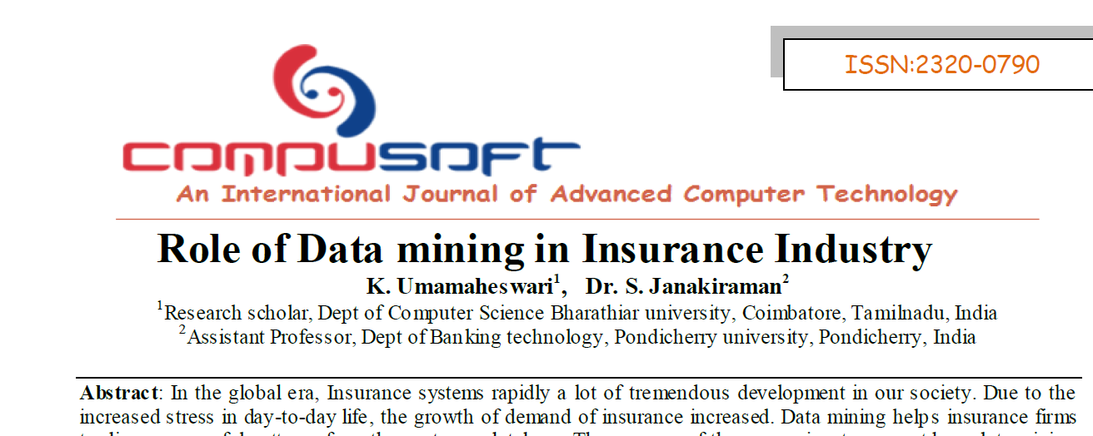
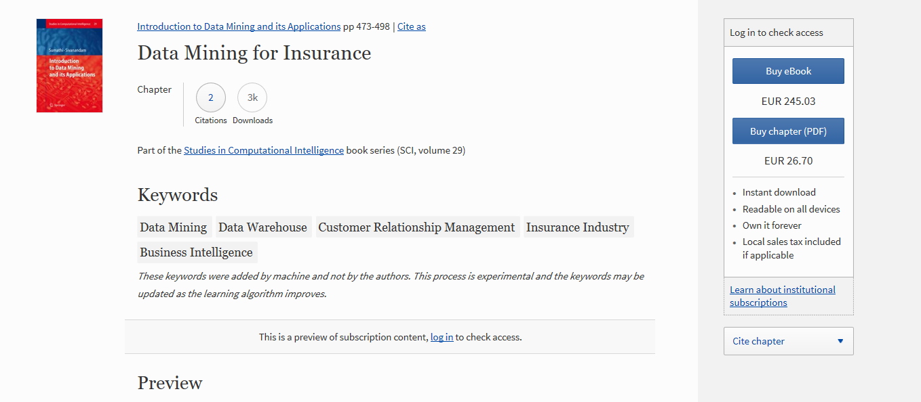

https://www.insurancebusinessmag.com/us/news/breaking-news/insurers-threaten-to-stop-covering-everest-trekkers-123429.aspx

Slide 8

Database
Himalayan Database
The Himalayan Database is a compilation of records for all expeditions that have climbed in the Nepal Himalaya.
The database is based on the expedition archives of Elizabeth Hawley, a longtime journalist based in Kathmandu, and it is supplemented by information gathered from books, alpine journals and correspondence with Himalayan climbers.
The Himalayan database describes 76.300+ mountaineering records for 465+ peaks with over 160 attributes, making it a comprehensive database for data mining.
https://www.himalayandatabase.com/index.html
Notes:
Frei zugängliche Datenbank als Download mit Abfragemaske und umfangreicher Dokumentation
Problem: nur Himalaya. Nicht Pakistan (K2 oder andere Hochgebirge in Pakistan, Südamerika) oder
„schwere Berge“ in Schweiz, Chile o. ä.)

Slide 9

Data Veracity
Database depends on correct information from the climbing community. Is the database respected?
Community adoption
Is the data already in use for other scientific research (e.g. high altitude medicine, sports)?
Scientific adoption
Are publicly known ascents/ accidents traceable in the database?
External verification
Notes:
Die Datenbank ist umfangreich, detailliert und gut dokumentiert.
Um die Daten für unsere Zwecke nutzen zu können müssen wir die Datenbasis aber auch auf Verlässlichkeit überprüfen.
Wir haben dazu drei weiche Kriterien definiert
Da die Datenbank auf Angaben der Bergsteiger angewiesen ist, wollen wir wissen wie akzeptiert die Datenbank in Bergsteiger Kreisen ist
Ein weiteres Indiz für die Verlässlichkeit ist die Verwendung in Wissenschaft
Zudem haben wir versucht, Vorfälle aus anderen Quellen in der Datenbank nachzuvollziehen
What Is Data Veracity?
Data veracity, in general, is how accurate or truthful a data set may be. In the context of big data, however, it takes on a bit more meaning. More specifically, when it comes to the accuracy of big data, it’s not just the quality of the data itself but how trustworthy the data source, type, and processing of it is. Removing things like bias, abnormalities or inconsistencies, duplication, and volatility are just a few aspects that factor into improving the accuracy of big data.
https://www.gutcheckit.com/blog/veracity-big-data-v/

Slide 10

Data Veracity
Database depends on correct information from the climbing community. Is the database respected among climbers?
Community adoption
Is the data already in use for other scientific research (e.g. high altitude medicine, sports)?
Scientific adoption
Are publicly known ascents/ accidents traceable in the database?
External verification
Notes:
Kernaussagen des Artikels:
HDB – nearest thing to an official record of climbes made in the himalaya
If a … wants … recognition that they have reached the summit they will need to get the approval
https://www.bbc.com/news/world-south-asia-10268549

Slide 11
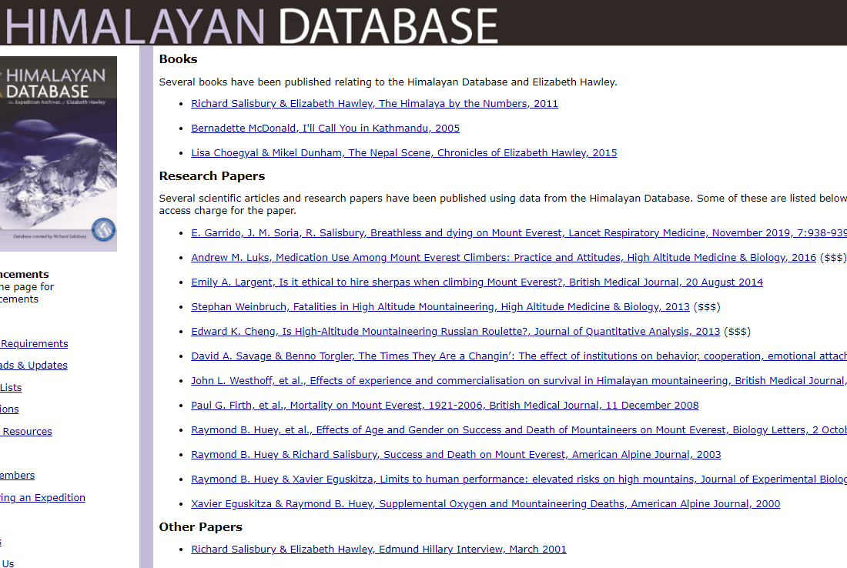
Data Veracity
Database depends on correct information from the climbing community. Is the database respected?
Community adoption
Is the data already in use for other scientific research (e.g. high altitude medicine, sports)?
Scientific adoption
Are publicly known ascents/ accidents traceable in the database?
External verification
Notes:
Die Datenbank wurde bereits für eine Vielzahl an Forschungsarbeiten zu den Themen
Medizin (Lungen- u. Höhenmedizin)
Einsatz von Sherpas
Gruppendynamik
Kommerzialisierung des Bergsteigens
Effekt von Alter und Geschlecht auf die Sterblichkeit
Forschung hauptsächlich in der statistischen Auswertung bestimmter Fragestellungen. Kein Versuch
Sterblichkeitswahrscheinlichkeiten durch DataScince Methoden zu bestimmen.

Slide 12

Data Veracity
Database depends on correct information from the climbing community. Is the database respected?
Community adoption
Is the data already in use for other scientific research (e.g. high altitude medicine, sports)?
Scientific adoption
Are publicly known ascents/ accidents traceable in the database?
External verification
Notes:
Der letzte, vielleicht schwächste Indikator: können zufällig ausgewählte Ereignisse aus anderen Quellen durch
Die Datenbank verifiziert werden.
Ja.

Slide 13
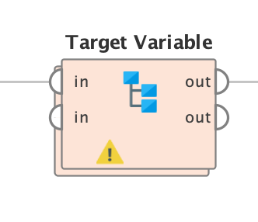
Data Preparation
Discretize
Age & Height
Climber Experience
Variable Preselection
Target variable
Reduce variance in certain attributes
Refers to a good or service being offered by a company.
Generate and prepare ???
Refers to a good or service being offered by a company.

Slide 14
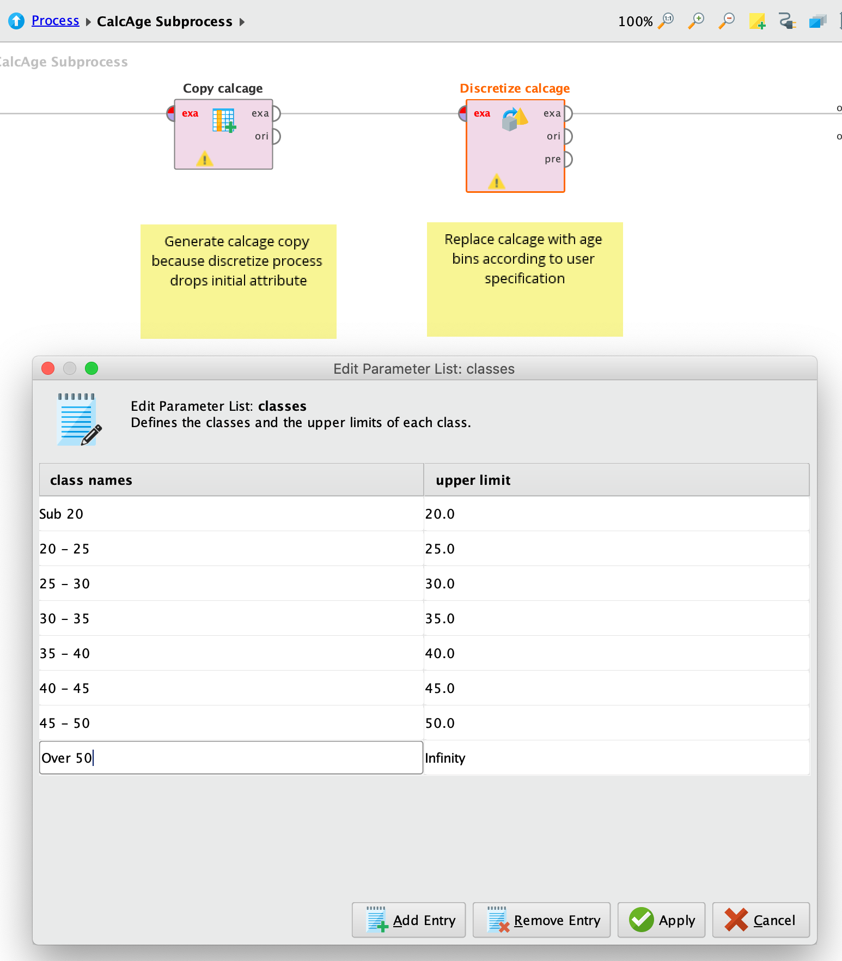
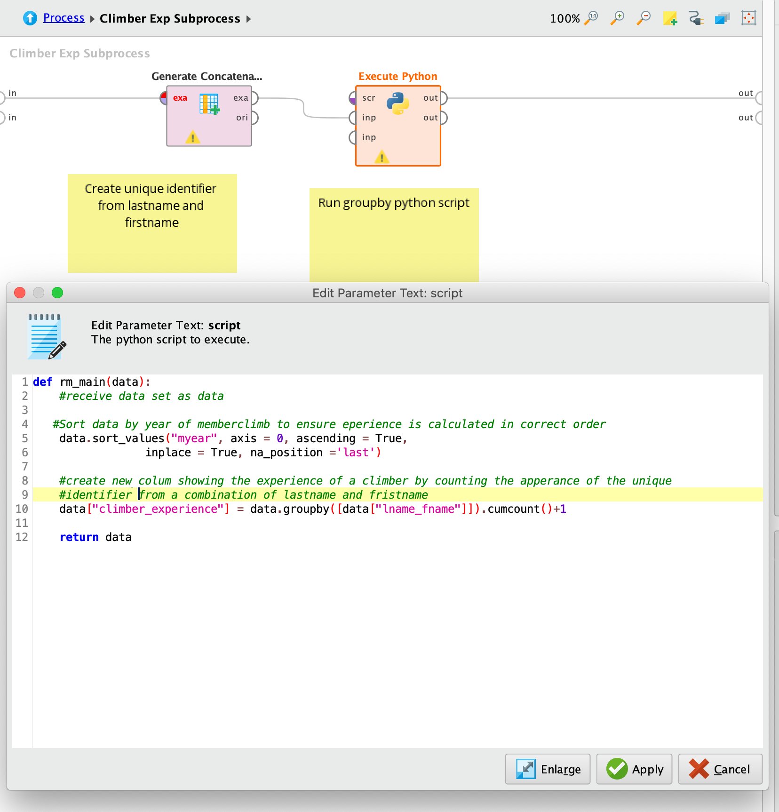
Age Groups
Refers to a good or service being offered by a company. Ideally, a product should meet a certain consumer demand, or it should be so compelling that consumers believe they need it.
Climber Experience
Refers to a good or service being offered by a company. Ideally, a product should meet a certain consumer demand, or it should be so compelling that consumers believe they need it.

Slide 15
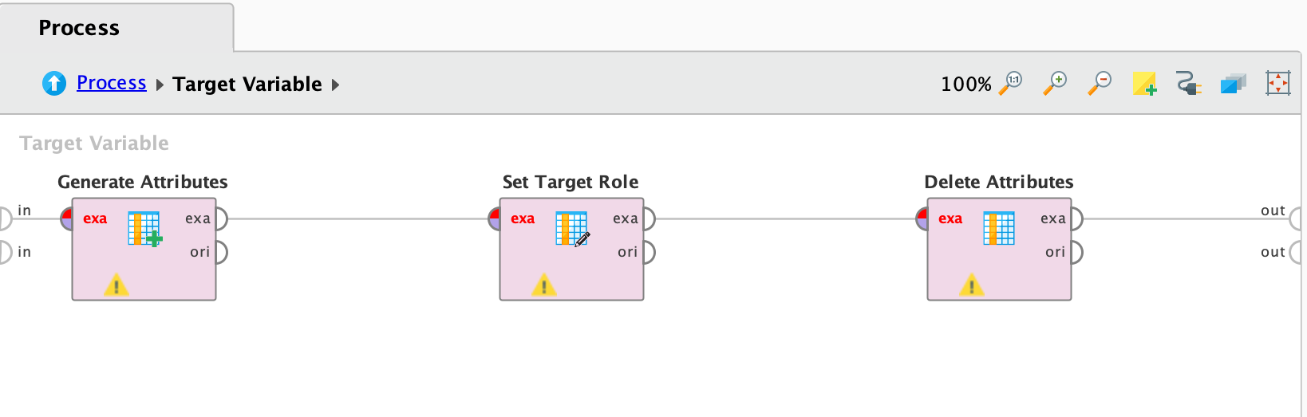
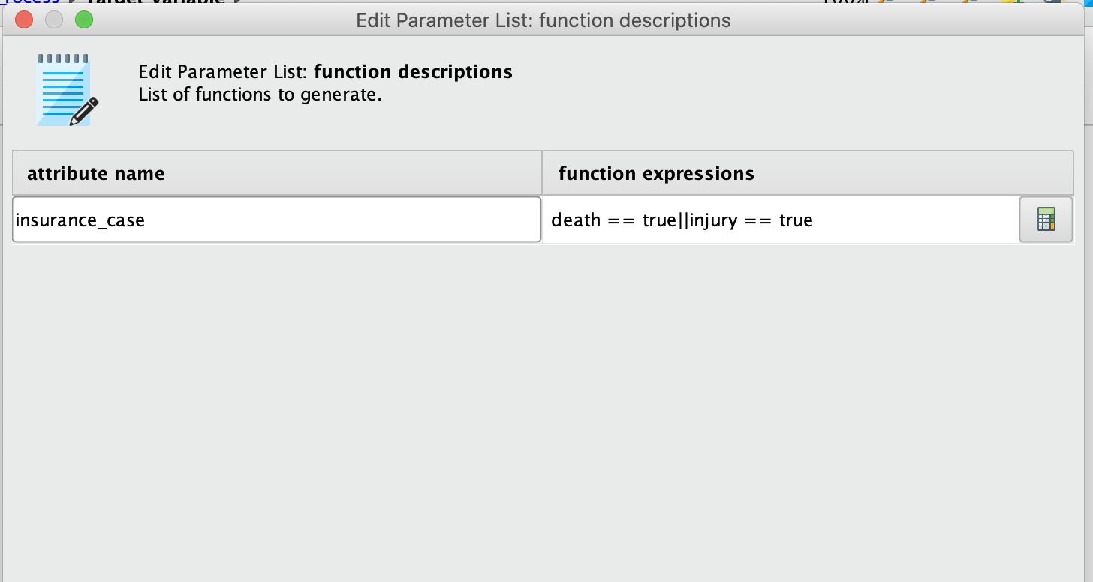
Target variable (insurance_case)
- Combine case of death or injury to insurance_case
- Set insurance_case to target variable
- Delete attribute death and injury from dataset to avoid GINI KOEFFIZIENT

Slide 16
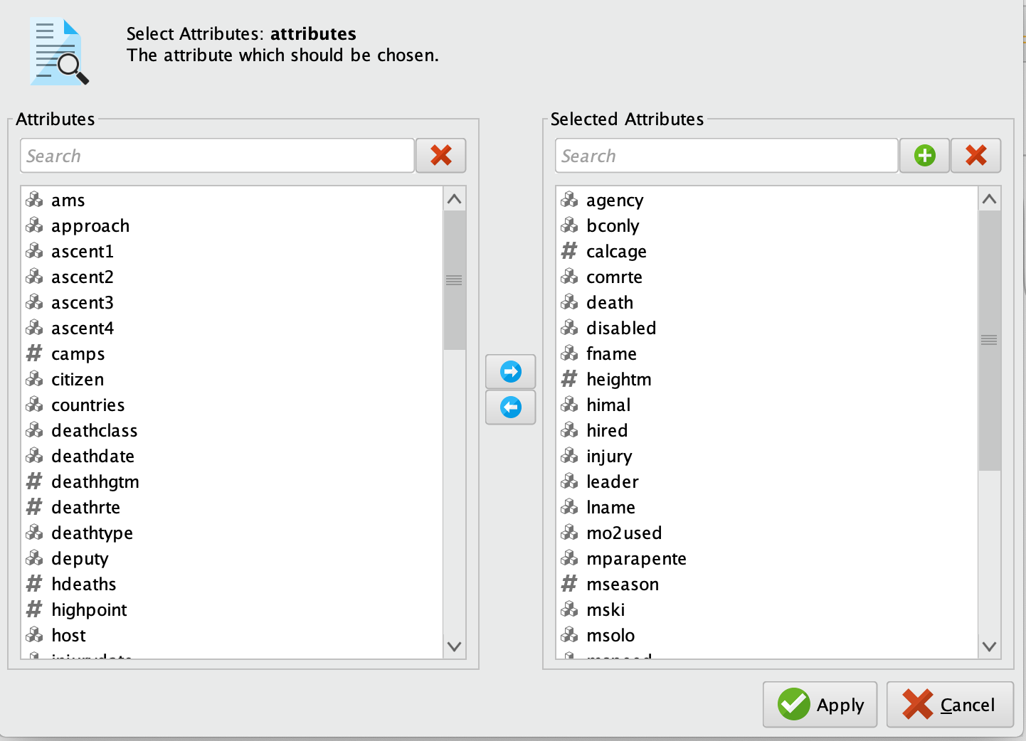
Variable Preselection
- Reduction of unnecessary detail
(e.g. where o2 was used, type of injury or death)
Deletion of redundant information
Deletion of attributes possibly not known to the customer in advance
(e.g. number of ascents, number of hired Sherpa)

Slide 17
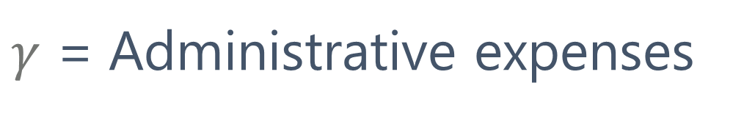
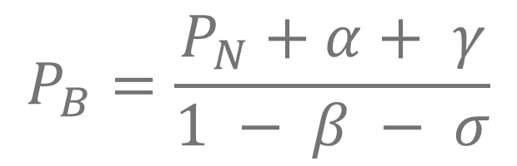


Insurance Premium Calculation
$γ$ = Administrative expenses
during insurance contract
C = Insurance claim
α = Acquisition costs
$$P_{B}=\frac{P_{N}+α+ γ}{1 − β − σ}$$
$P_{N}=$C * $P_{ic}$ *
*simplified
$β$ = Administrative expenses
pre insurance contract / payment phase
σ = Security surcharge
Notes:
Vereinfachtes Modell auf Basis einer Lebensversicherung
LV rechnet mit Pic Sterbetabellen, außerdem werden „Zinseinkünfte“ durch Anlage der Versicherungsprämie eingerechnet
Für unsere Zwecke genügt die vereinfachte Basis aus Eintrittswahrscheinlichkeit des Ereignisses * Versicherungssumme (Claim)
PB = Bruttoprämie
Die Nettoprämie wird mit verschiedenen Kostenfaktoren der Versicherung zu einer Bruttoprämie verrechnet, die vom Kunden zu zahlen ist. Hier werden Verwaltungskosten, Sicherheitsfaktor, Gewinn o. Ä. eingerechnet.
Alpha = Abschlusskosten (Provision o. Ä,)
Beta = Verwaltungskosten während der Zahlungsphase
Gamma = Verwaltungskosten während der Versicherungsphase
Sigma = Sicherheitsfaktor

Slide 18
Cases
15%
75%
40%
60%
Client 1
Client 2
Client 3
Client 4
Female
Everest
without Oxygen
3rd climb
30 - 35
Male
Everest
without Oxygen
3rd climb
30 - 35
Refers to a good or service being offered by a company.
Refers to a good or service being offered by a company.
Notes:
Vergleichswerte aus Blogs
Insurance $70 – $3,000
Evacuation Insurance $70 (American Alpine Club) – ~$500 (Global Rescue/TravelEx)
Medical only $500
Rescue Insurance for any reason with medical insurance and trip cancellation coverage – $3,000 to $5,000 (TravelEx)
Private pay helicopter evacuation from Everest South – $5,000 – $20,000 depending on start and end locations (not available on north, but planned)
All insurance figures are representative and will vary widely with age, length of trip and total cost.
http://www.alanarnette.com/blog/2019/12/01/how-much-does-it-cost-to-climb-mount-everest-2020-edition/#3

Slide 19
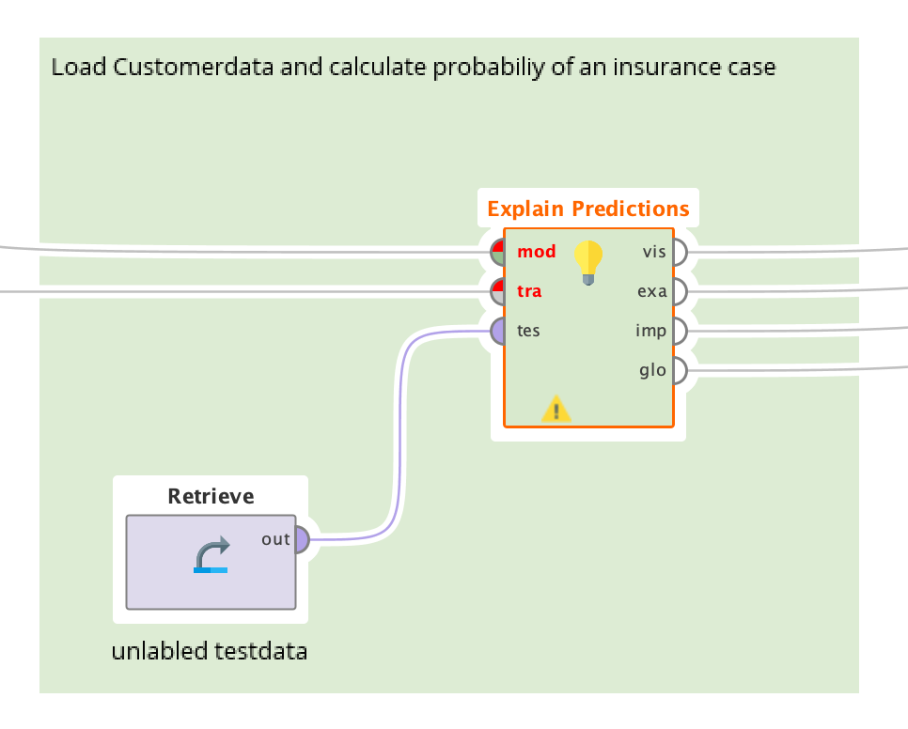

Slide 20
About Us
Marketers must link the price to the real and perceived value of the product, but they also must.

Slide 21
A Welcome Wear
Ben Robertson
The type of product also partially dictates how much businesses. In some cases, business executives may manipulate a price to make a product seem more like a luxury.

Slide 22
A Welcome Wear
Ben Robertson
The type of product also partially dictates how much businesses. In some cases, business executives may manipulate a price to make a product seem more like a luxury.

Slide 23
Our Company Values
Element One
Marketers must link the price to the real and perceived value of the product, but they also a certain consumer demand.
Element Two
Marketers must link the price to the real and perceived value of the product, but they also a certain consumer demand.
Element Three
Marketers must link the price to the real and perceived value of the product, but they also a certain consumer demand.
Element Four
Marketers must link the price to the real and perceived value of the product, but they also a certain consumer demand.

Slide 24
Our Company Values
Title One
Title Two
Title Three
Title Four
Title Five
Refers to a good or service being.
Refers to a good or service being.
Refers to a good or service being.
Refers to a good or service being.
Refers to a good or service being.

Slide 25
Our Company Values
Write Your Title Here
Write Your Title Here
Marketers must link the price to the real and perceived value of the product.
Marketers must link the price to the real and perceived value of the product.
Write Your Title Here
Write Your Title Here
Marketers must link the price to the real and perceived value of the product.
Marketers must link the price to the real and perceived value of the product.

Slide 26
Our Company Values
Title One
Title Two
Title Three
Title Four
Place decisions outline where the product is sold and how it is delivered.
Place decisions outline where the product is sold and how it is delivered.
Place decisions outline where the product is sold and how it is delivered.
Place decisions outline where the product is sold and how it is delivered.

Slide 27
Our Company Values
Title One
The type of product.
Marketers must link the price to the real and perceived value of the product, but they also must take into account supply costs, seasonal discounts, and prices used by competitors. In some cases, business executives. Place decisions outline where the product is sold and how it is delivered to the market.
The goal of business executives is to get their products in front of the consumers who are most likely to buy them.
Title Two
Marketers must link.
Title Tree
Account supply costs.
Title Four
Business executives.

Slide 28
Our Company Values
Title One
Title Two
Title Three
Refers to a good or service being offered by a company.
Refers to a good or service being offered by a company.
Refers to a good or service being offered by a company.

Slide 29
Title One
Our Company Values
The type of product.
Marketers must link the price to the real and perceived value of the product, but they also must take into account supply costs, seasonal discounts, and prices used by competitors. In some cases, business executives. Place decisions outline where the product is sold and how it is delivered to the market.
The goal of business executives is to get their products in front of the consumers who are most likely to buy them.
Title Two
Marketers must link.
Title Tree
Account supply costs.
Title Four
Business executives.

Slide 30
Business Philisophy
Title One
Refers to a good or service being offered by a company. Ideally, a product should meet a certain consumer demand, or it should be so compelling that consumers believe they need it. But they also must take into account supply costs.
The goal of business executives is to get their products in front of the consumers who are most likely to buy them.

Slide 31
Business Philisophy
Title One
Refers to a good or service being offered by a company. Ideally, a product should meet a certain consumer demand, or it should be so compelling that consumers believe they need it. But they also must take into account supply costs.
The goal of business executives is to get their products in front of the consumers who are most likely to buy them.

Slide 32
Company’s Timeline
Title Two
Title Four
Marketers must link the price to the real.
Marketers must link the price to the real.
Title One
Title Three
Marketers must link the price to the real.
Marketers must link the price to the real.

Slide 33
“The future belongs to those who believe in the beauty of their dreams”
— Eleanor Roosevelt
Place decisions outline where the product is sold and how it is delivered to the market. The goal of business executives is to get their products in front of the consumers who are most likely to buy them.

Slide 34
Title One
Refers to a good or service being offered by a company. Ideally, a product should meet a certain consumer demand, or it should be so compelling that consumers believe they need it. But they also must take into account supply costs
Title Two
Refers to a good or service being offered by a company. Ideally, a product should meet a certain consumer demand, or it should be so compelling that consumers believe they need it. But they also must take into account supply costs.

Slide 35
Professional Business & Consulting
Title One
Something about us
The type of product also partially dictates how much businesses. In some cases, business executives may manipulate a price to make a product.
Title Two
Something about us

Slide 36
Title One
Refers to a good or service being offered by a company. Ideally, a product should meet a certain consumer demand, or it should be so compelling that consumers believe they need it. But they also must take into account supply costs
Title Two
Refers to a good or service being offered by a company. Ideally, a product should meet a certain consumer demand, or it should be so compelling that consumers believe they need it. But they also must take into account supply costs.

Slide 37
Professional Business & Consulting
Title One
Something about us
The type of product also partially dictates how much businesses. In some cases, business executives may manipulate a price to make a product.
Title Two
Something about us

Slide 38
Title One
Title Two
Marketers must link the price to the real and perceived value of the product, but they also must take into account supply costs.
Marketers must link the price to the real and perceived value of the product, but they also must take into account supply costs.

Slide 39
Title One
Title Two
Marketers must link the price to the real and perceived value of the product, but they also must take into account supply costs.
Marketers must link the price to the real and perceived value of the product, but they also must take into account supply costs.

Slide 40
Our Mission
“Successful people keep moving. They make mistakes, but they don’t quit.”
Refers to a good or service being offered by a company. Ideally, a product should meet a certain consumer demand, or it should be so compelling that consumers believe they need it.

Slide 41
Meet Our Team
Halie Meagan
John Smith
Katy Mills
Ryan McGill
Marketers must link the price to the real
Marketers must link the price to the real
Marketers must link the price to the real
Marketers must link the price to the real

Slide 42
Meet Our Team
Madison Bruke
The type of product also partially dictates how much businesses. In some cases, business executives may manipulate a price to make a product seem more like a luxury.

Slide 43
Meet Our Team
Amanda Smith
David Nicholson
Marketers must link the price to the real and perceived value.
Marketers must link the price to the real and perceived value.
Madison Bruke
Katy Mills
Marketers must link the price to the real and perceived value.
Marketers must link the price to the real and perceived value.

Slide 44
Meet Our Team
Halie Meagan
Bryan McGill
Ben Anderson
Madison Bruke
Refers to a good or service being offered by a company.
Refers to a good or service being offered by a company.
Refers to a good or service being offered by a company.
Refers to a good or service being offered by a company.

Slide 45
Meet Our Team
Katy Mills
Ryan McGill
Paola Randal's
Service being offered by a company. Ideally, a product should meet a certain.
Service being offered by a company. Ideally, a product should meet a certain.
Service being offered by a company. Ideally, a product should meet a certain.

Slide 46
Meet Our Team
Halie Meagan
Bryan McGill
Ben Anderson
Madison Bruke
Refers to a good or service being offered by a company.
Refers to a good or service being offered by a company.
Refers to a good or service being offered by a company.
Refers to a good or service being offered by a company.

Slide 47
Title One
Refers to a good or service being offered by a company. Ideally, a product should meet a certain consumer demand, or it should be so compelling that consumers believe they need it.
Title Two
Refers to a good or service being offered by a company. Ideally, a product should meet a certain consumer demand, or it should be so compelling that consumers believe they need it.

Slide 48
Title One
Refers to a good or service being offered by a company. Ideally, a product should meet a certain consumer demand, or it should be so compelling that consumers believe they need it.
Title Two
Refers to a good or service being offered by a company. Ideally, a product should meet a certain consumer demand, or it should be so compelling that consumers believe they need it.

Slide 49
Subscribing Plans
Title One
Title Two
$39
Marketers must link the price to the real and perceived value.
$49
Marketers must link the price to the real and perceived value.
Title Three
Title Four
$79
Marketers must link the price to the real and perceived value.
$99
Marketers must link the price to the real and perceived value.

Slide 50
Subscribing Plan
$3240
$435
Place decisions outline where the product is sold and how it is delivered.
Place decisions outline where the product is sold and how it is delivered.
Marketers must link the price to the real and perceived value of the product, but they also must take into account supply costs, seasonal discounts, and prices used by competitors. In some cases, business executives. Place decisions outline where the product is sold and how it is delivered to the market.
The goal of business executives is to get their products in front of the consumers who are most likely to buy them.
$273
$1270
Place decisions outline where the product is sold and how it is delivered.
Place decisions outline where the product is sold and how it is delivered.

Slide 51
Subscribing Plans
$199
The goal of business executives is
$239
Place decisions outline where
$329
Place decisions outline where
$439
The goal of business executives is

Slide 52
Subscribing Plans
$39
$49
$79
$99
Refers to a good or service being offered by a company.
Refers to a good or service being offered by a company.
Refers to a good or service being offered by a company.
Refers to a good or service being offered by a company.

Slide 53
Revenue Model
Marketers must link the price to the real and perceived value of the product, but they also must take into account supply costs, seasonal discounts, and prices used by competitors. In some cases, business executives. To be successful, marketers should understand the life cycle of a product, and business executives should have a plan for dealing with products at every stage of their life cycles.
Title One
Title Two
Title Two
Title Two
47%
24%
24%
24%
Refers to a good or service.
Refers to a good or service.
Refers to a good or service.
Refers to a good or service.

Slide 54
Revenue Model
+120
+70
Refers to a good or service being offered by a company. Ideally, a product should meet a certain consumer demand, or it should be so compelling that consumers believe they need it.
Refers to a good or service being offered by a company.
Refers to a good or service being offered by a company.

Slide 55
Title One
Title Two
Title Two
Title Two
47%
24%
24%
24%
Refers to a good or service.
Refers to a good or service.
Refers to a good or service.
Refers to a good or service.
Revenue Model
Marketers must link the price to the real and perceived value of the product, but they also must take into account supply costs, seasonal discounts, and prices used by competitors. In some cases, business executives. To be successful, marketers should understand the life cycle of a product, and business executives should have a plan for dealing with products at every stage of their life cycles.

Slide 56
Revenue Model
Title One
Title Two
+250
+743
Refers to a good or service.
Refers to a good or service.

Slide 57
Market Validation
+4128
Product should meet a certain consumer demand, or it should be so compelling that consumers believe they need it.
+7390
Product should meet a certain consumer demand, or it should be so compelling that consumers believe they need it.
TITLE A
TITLE B
TITLE C
TITLE D

Slide 58
Market Validation
Marketers must link the price to the real and perceived value of the product, but they also must take into account supply costs, seasonal discounts, and prices used by competitors. In some cases, business executives. To be successful, marketers should understand the life cycle of a product, and business executives should have a plan for dealing with products at every stage of their life cycles. Business executives should have a plan for dealing with products at every stage of their life cycles..
Project One
Project Two
47%
24%
Refers to a good or service.
Refers to a good or service.

Slide 59
Market Validation
+34
+10
+207
+45
Title One
Title Two
Title Three
Title Four
Refers to a good or service being offered by a company.
Refers to a good or service being offered by a company.
Refers to a good or service being offered by a company.
Refers to a good or service being offered by a company.

Slide 60
Market Validation
Marketers must link the price to the real and perceived value of the product, but they also must take into account supply costs, seasonal discounts, and prices used by competitors. In some cases, business executives. To be successful, marketers should understand the life cycle of a product, and business executives should have a plan for dealing with products at every stage of their life cycles. Business executives should have a plan for dealing with products at every stage of their life cycles..
Project One
Project Two
47%
24%
Refers to a good or service.
Refers to a good or service.

Slide 61

Phone
Preview Sample
Title One
Marketers must link the price to the real.
Title Two
Marketers must link the price to the real.

Slide 62
Phone Preview Sample
Title One
Title Two
Marketers must link the price to the real.
Marketers must link the price to the real.

Slide 63
Tablet Preview Sample
Title One
Title Three
Marketers must link the price to the real.
Marketers must link the price to the real.
Title Two
Title Four
Marketers must link the price to the real.
Marketers must link the price to the real.

Slide 64
Phone Preview Sample
Title One
Title Two
Marketers must link the price to the real.
Marketers must link the price to the real.
Marketers must link the price to the real and perceived value of the product, but they also must take into account supply costs, seasonal discounts, and prices used by competitors. In some cases, business executives.

Slide 65

Laptop Preview Sample

Slide 66
Laptop Preview Sample
Your Title
Marketers must link the price to the real and perceived value of the product, but they also must take into account supply costs, seasonal discounts, and prices used by competitors.

Slide 67
Diagram Section
A
B
C
D
Refers to a good or service being offered by a company.
Refers to a good or service being offered by a company.
Refers to a good or service being offered by a company.
Refers to a good or service being offered by a company.

Slide 68
Diagram Section
Mission
Vision
Goals
Values
Strategy
Alive or dead a fish is technically fast
Alive or dead a fish is technically fast
Alive or dead a fish is technically fast
Alive or dead a fish is technically fast
Alive or dead a fish is technically fast

Slide 69
Diagram Section
Your Title
Your Title
Service being offered by a company, ideally, a product.
Service being offered by a company, ideally, a product.
Your Title
Your Title
Service being offered by a company, ideally, a product.
Service being offered by a company, ideally, a product.

Slide 70
Diagram Section
Marketers must link the price to the real and perceived value of the product.
Title One
Marketers must link the price to the real and perceived value of the product.
Title Two
Marketers must link the price to the real and perceived value of the product.
Title Three

Slide 71
Diagram Section
Your Title
Your Title
Marketers must link the price to the real and perceived value.
A
C
Marketers must link the price to the real and perceived value.
Your Title
Your Title
Marketers must link the price to the real and perceived value.
B
D
Marketers must link the price to the real and perceived value.

Slide 72
Diagram Section
A
Write Your Title Here
Refers to a good or service being offered by a company.
B
Write Your Title Here
Refers to a good or service being offered by a company.
C
Write Your Title Here
Refers to a good or service being offered by a company.
Write Your Title Here
D
Refers to a good or service being offered by a company.

Slide 73
Diagram Section
Your Title
Your Title
Your Title
Your Title
Marketers must link the price to the real and perceived value.
Marketers must link the price to the real and perceived value.
Marketers must link the price to the real and perceived value.
Marketers must link the price to the real and perceived value.

Slide 74
Graphic Charts
Title One
Title One
70%
Refers to a good or service being offered by a company.
Title Two
50%
Title Two
Refers to a good or service being offered by a company.
Title Three
90%
Title Three
Refers to a good or service being offered by a company.

Slide 75
Graphic Charts
15%
75%
40%
60%
Title One
Title Two
Title Three
Title Four
Refers to a good or service being offered by a company.
Refers to a good or service being offered by a company.
Refers to a good or service being offered by a company.
Refers to a good or service being offered by a company.

Slide 76
Graphic Charts
60
50
40
30
20
10
0
Title 01
Title 02
Title 03
Title 04
Title 05
Title 06
Title 07

Slide 77
Graphic Charts
90%
85%
65%
50%
40%
Title One
Title Two
Title Three
Title Four
Title Five
A telegraph wire, or a strand of cobweb.
A telegraph wire, or a strand of cobweb.
A telegraph wire, or a strand of cobweb.
A telegraph wire, or a strand of cobweb.
A telegraph wire, or a strand of cobweb.

Slide 78
Graphic Charts
Your Title
Service being offered by a company, ideally a product.
Your Title
Service being offered by a company, ideally a product.
Your Title
Refers to a good or service being offered by a company
Service being offered by a company, ideally a product.
70%
Your Title
Service being offered by a company, ideally a product.
Your Title
Service being offered by a company, ideally a product.

Slide 79
United Estates Editable Map
Title One
Title Two
+98
+480
Refers to a good or service.
Refers to a good or service.

Slide 80
Canada Editable Map
Title One
Title Two
+249
+34
Refers to a good or service.
Refers to a good or service.

Slide 81
Malaysia Editable Map
Title One
Title Two
+614
+70
Refers to a good or service.
Refers to a good or service.

Slide 82
Australia Editable Map
Title One
Title Two
+249
+34
Refers to a good or service.
Refers to a good or service.

Slide 83
China Editable Map
Title One
Title Two
+614
+70
Refers to a good or service.
Refers to a good or service.

Slide 84
Germany Editable Map
Title One
Title Two
+249
+34
Refers to a good or service.
Refers to a good or service.

Slide 86
Get In Touch With Us
Empire State Building
350 5th Ave, New York, NY 10118
(212) 736-3100
Send us a message or visit us. Whenever you like. Refers to a good our service.

Slide 87
thanks

